Slide 1

Accelerate Your Career and Others’ By Proving You’re a Badass

Slide 2


Slide 3
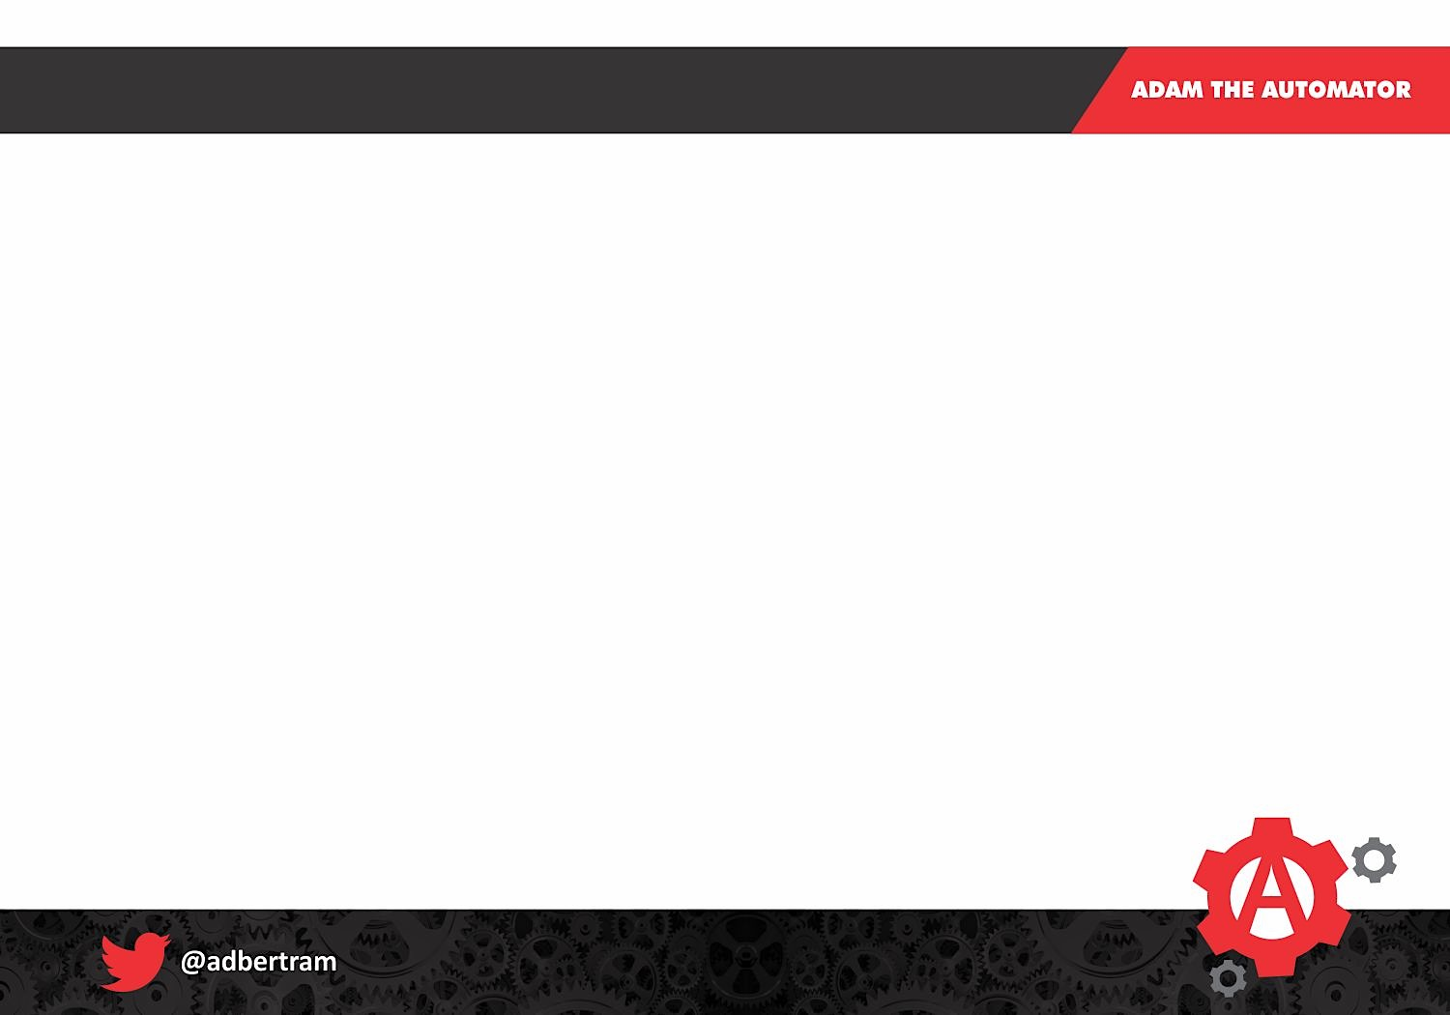

Excuses
Someone’s already done it
It’s not good enough
People will tell me I’m wrong
I don’t have time

Slide 4
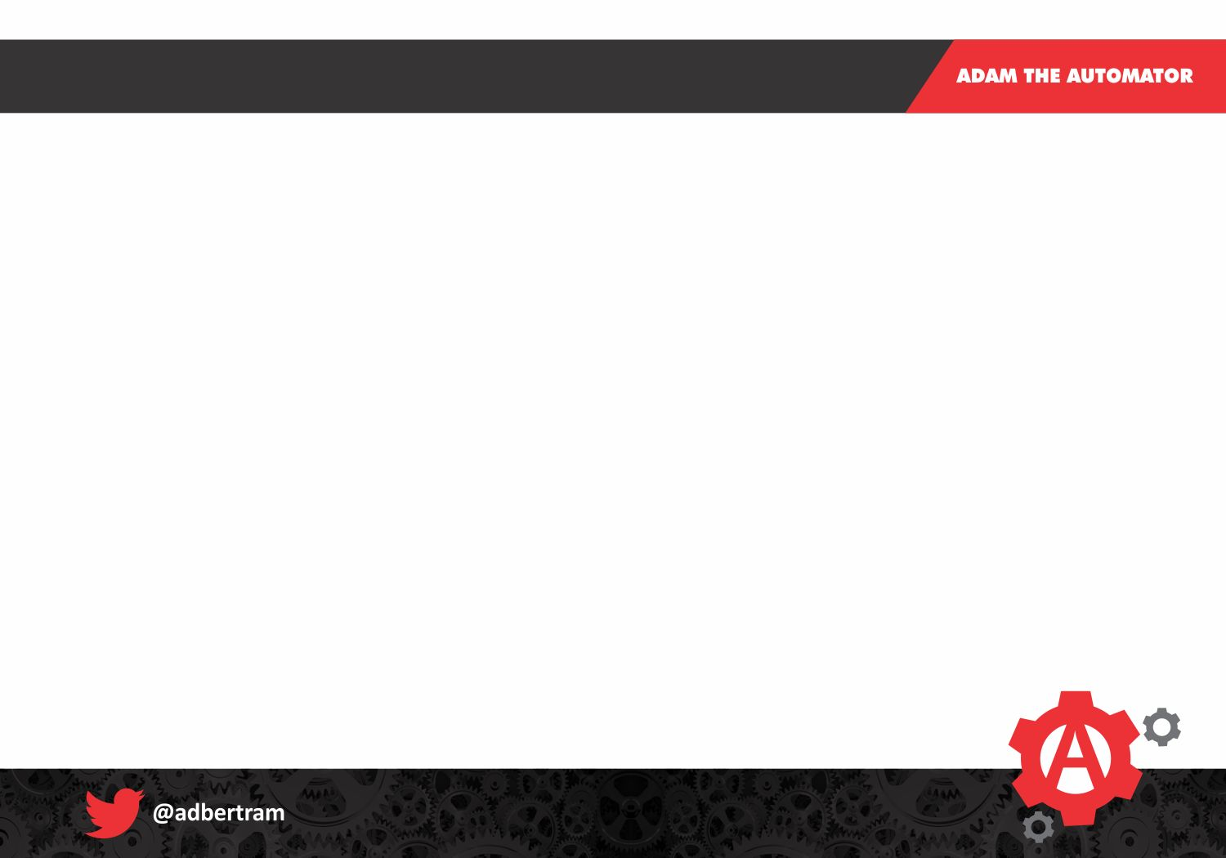
Just Stop
You DO Know Things Others Don’t!
You WILL help people!
You WILL feel awesome doing it!

Slide 5
You are Unique
Anyone can Google “How to use Get-Service” You make the content unique You write your story

Slide 6
What’s the Best that Could Happen?
Excelling at your job
Building your resume
Making more $$$
Accelerating learning
Helping others
Self-documentation
Getting a promotion

Slide 7
What’s the Worst that Could Happen?
You Suck!!

Slide 8
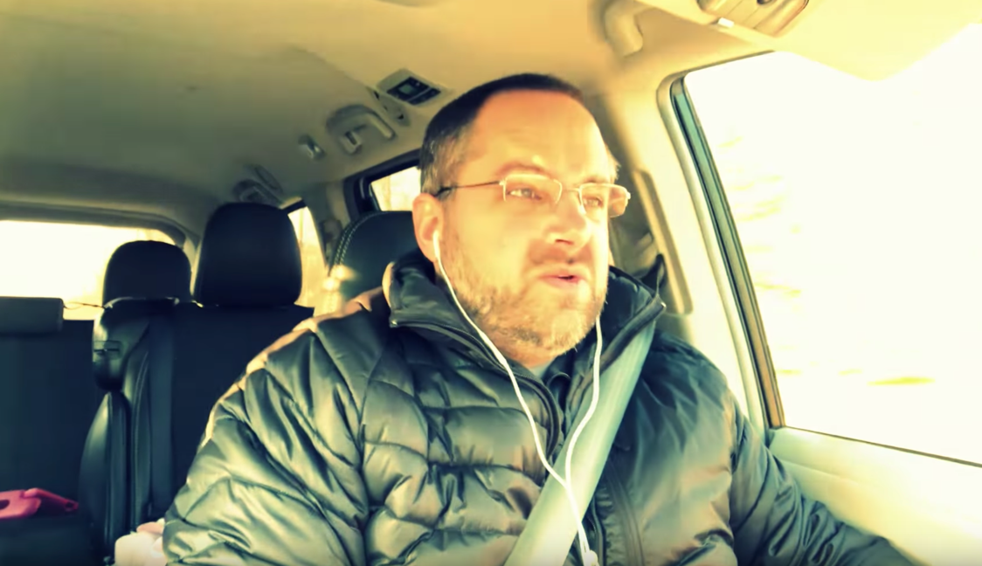
Zero Fucks Given
“Backseat temperature controls. This has gotta be a minivan.”
Pink iPad. Shameless remnants of my 9-year old.

Slide 9
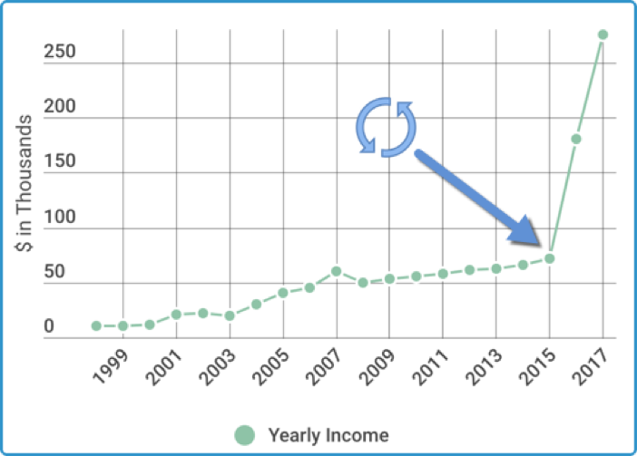
My Story
http://bit.ly/refreshcareer

Slide 10

Pick your Poison
Brown bag lunches at work
Podcasts
Blogging
User groups
Freelance writing
Mentoring
Training courses

Slide 11
Discuss!
Questions?
Comments?
Concerns?
Personal Attacks?

Slide 12


